Slide 1
Visualization Design & Tableau
Northwestern
Alessandro Febretti
Sr. Interactive Visualization Specialist

Slide 2
Overview
Intro to Tableau
Demo
Data preparation
Worksheet examples
From worksheets to dashboards
Publishing
Visualization Design

Slide 3
What is Tableau
Tool for fast data analytics
Strong focus on visual analytics
Core Idea: drag and drop ‘columns’ of your data into slots in a visualization worksheet. Tableau figures out
How to query the data
How to generate the best visualization based on (column, slot) map
Very popular for BI, can do much more than that.

Slide 4
What Tableau Isn’t
Tableau is not a tool for editing your data
In general data sources are treated as read-only
You can create intermediate columns / tables that exist only in Tableau
You can still export data…

Slide 5
Editions and Getting Tableau
Tableau Desktop
We are going to use this
30-day trial available
Tableau Public
Free
Limited data sources / data size
Can only save online on public Tableau service
Tableau Viewer
View dashboards created with Tableau Desktop
Free
Limited interaction / packaged workbooks only
Tableau Server
Cloud or on-premises processing
= Tableau Public but you don’t have to share your vis

Slide 6
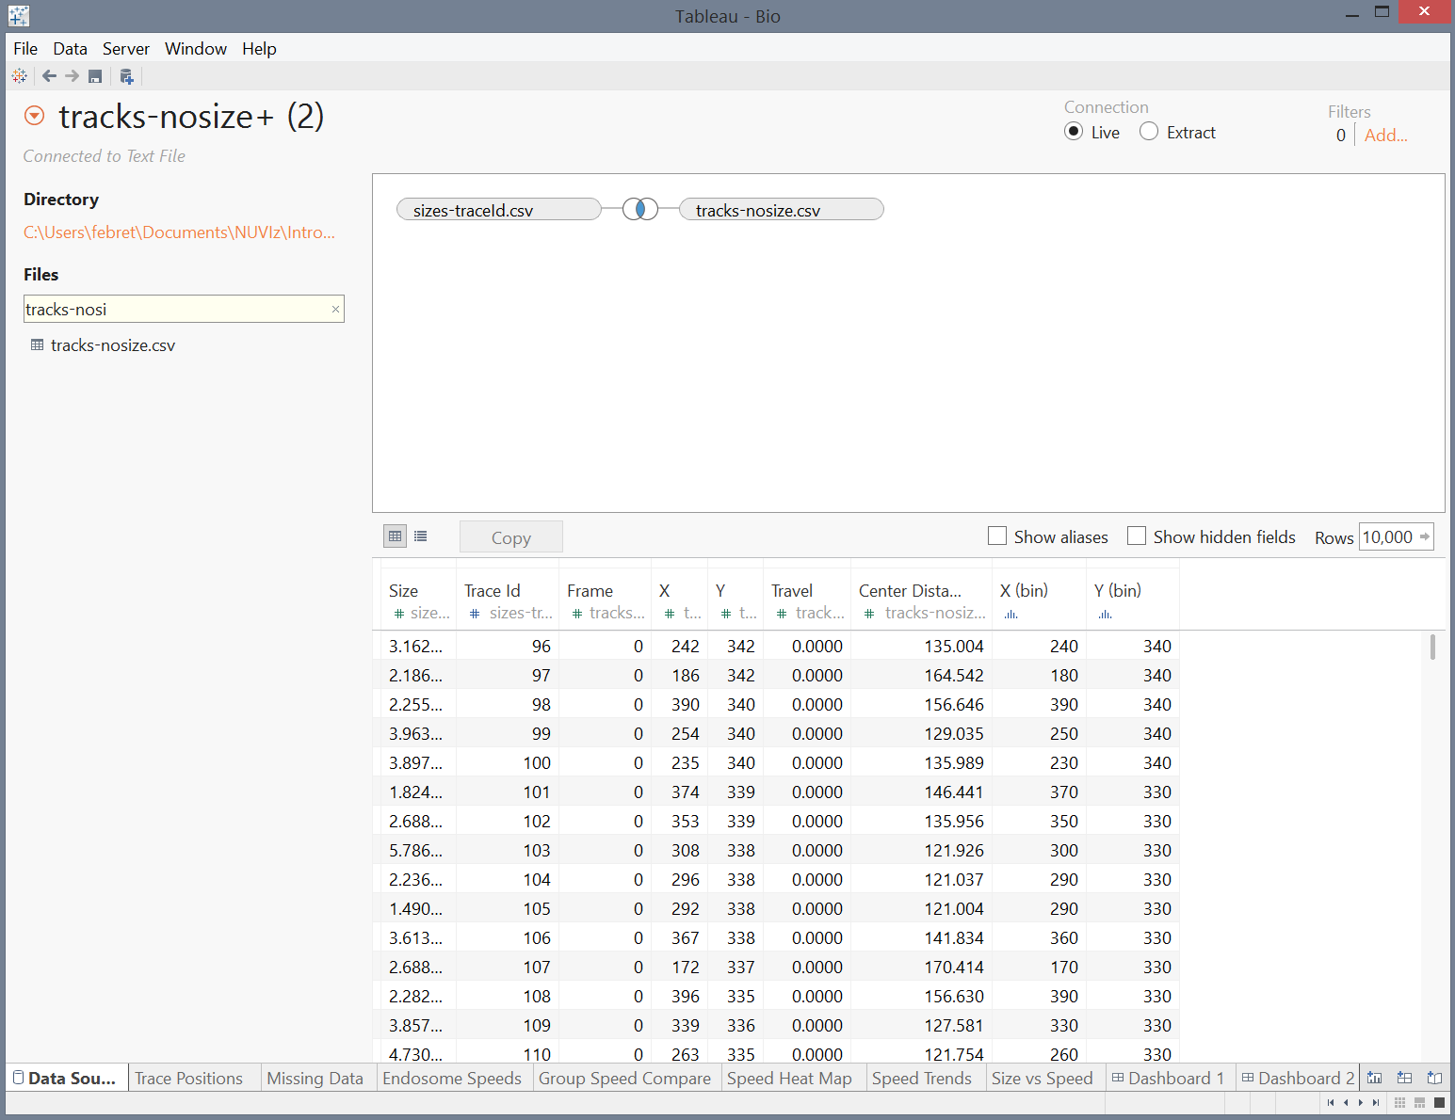
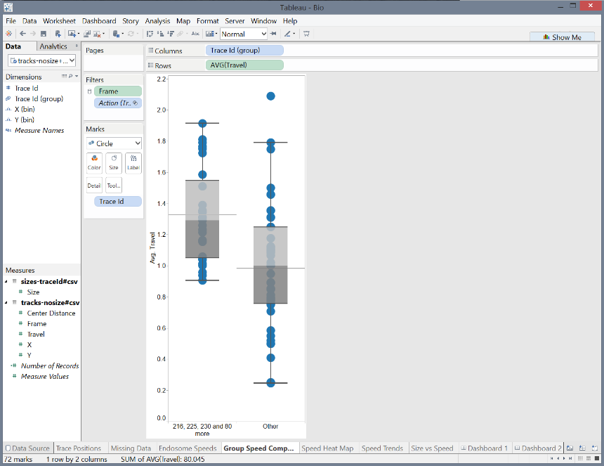
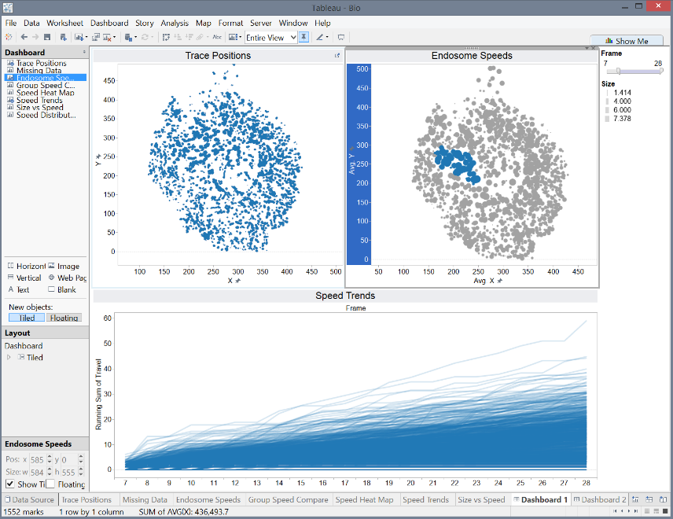
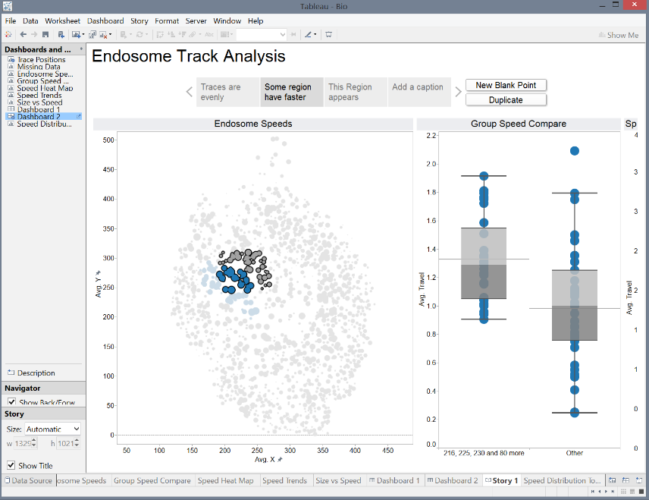
Main Interfaces
Data Sources
Worksheet
Dashboard
Story

Slide 7
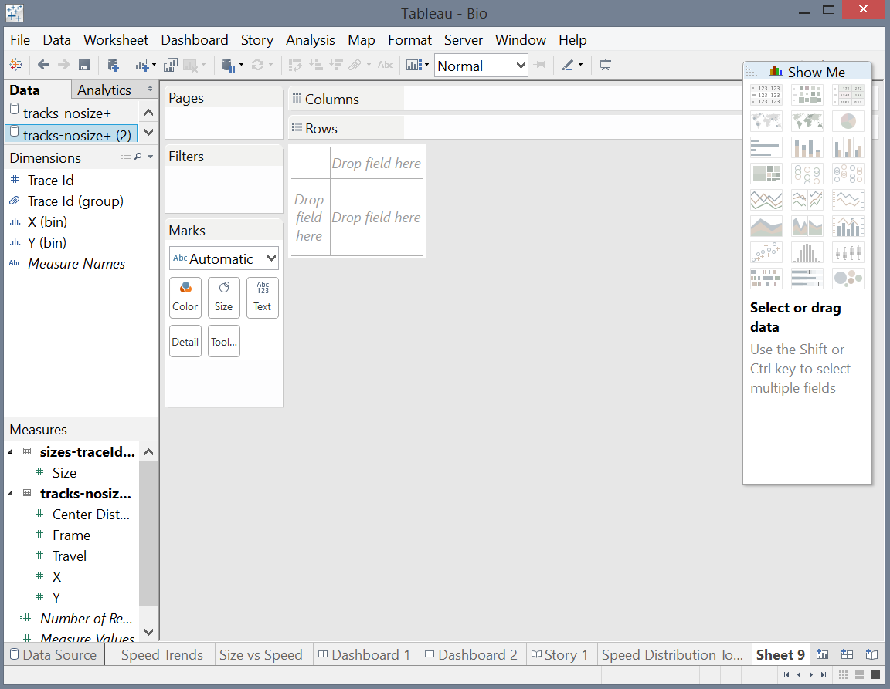
Tableau Worksheet
Data Fields
Data Panes
Visualization Area
Quick Views

Slide 8

Demo Time!
https://github.com/febret/TableauExample
Notes:
38

Slide 9
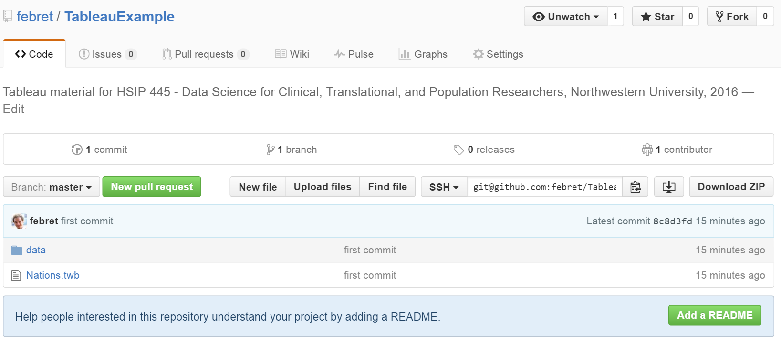
Download Data & Sample
Original Data: UN Environmental Data Explorer (http://geodata.grid.unep.ch/)
GDP, Life Expectancy, Population By Country, 1950-2010
Pre-processed data & Tableau sample: Download from github (https://github.com/febret/TableauExample)

Slide 10
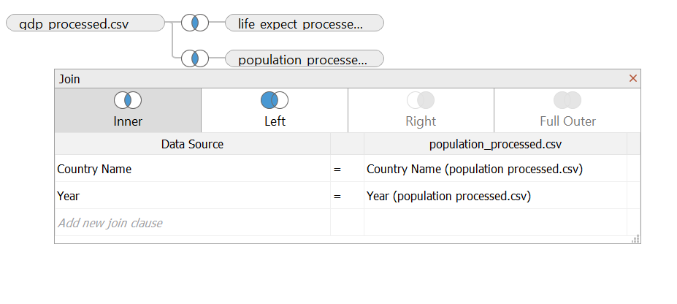
Importing Data
Pivot, Hide Fields & Join
Notes:
We pivot on a separate example dataset, we don’t have time to go through all the data processing steps.

Slide 11
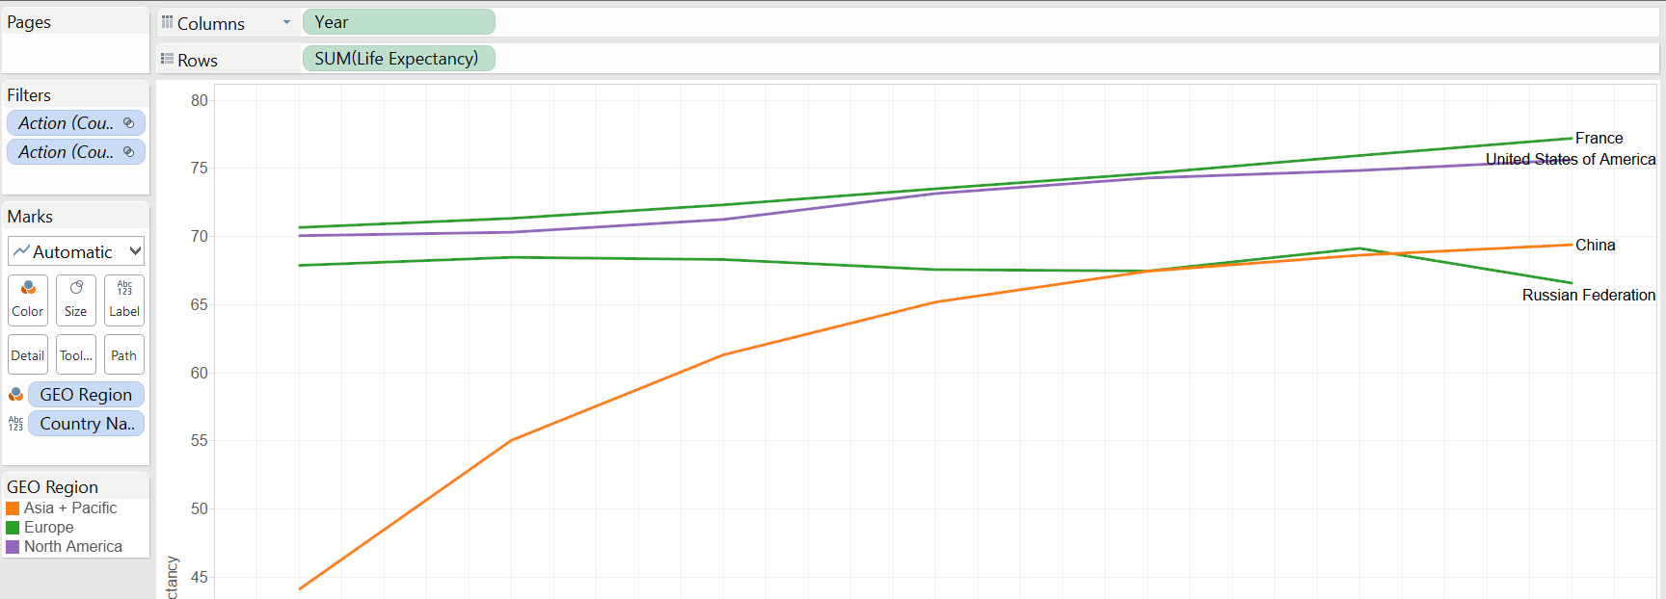
Live Expectancy over Year

Slide 12
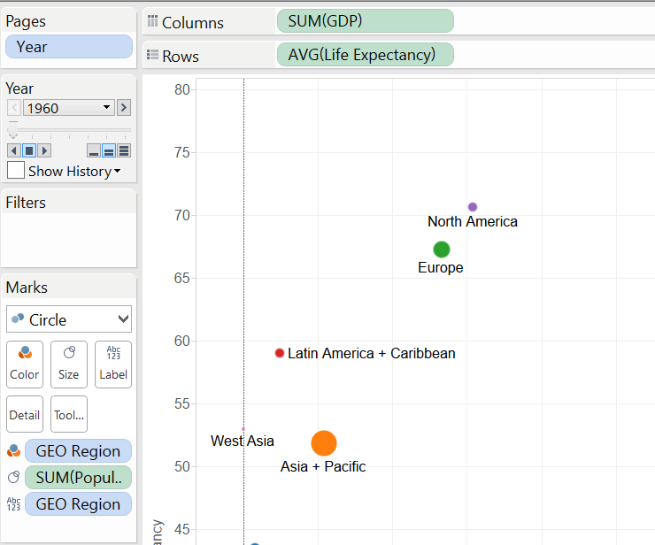
Animated Scatterplot: GDP/Life Expectancy
Notes:
Switch Between Aggregated & Non-Aggregated Views

Slide 13
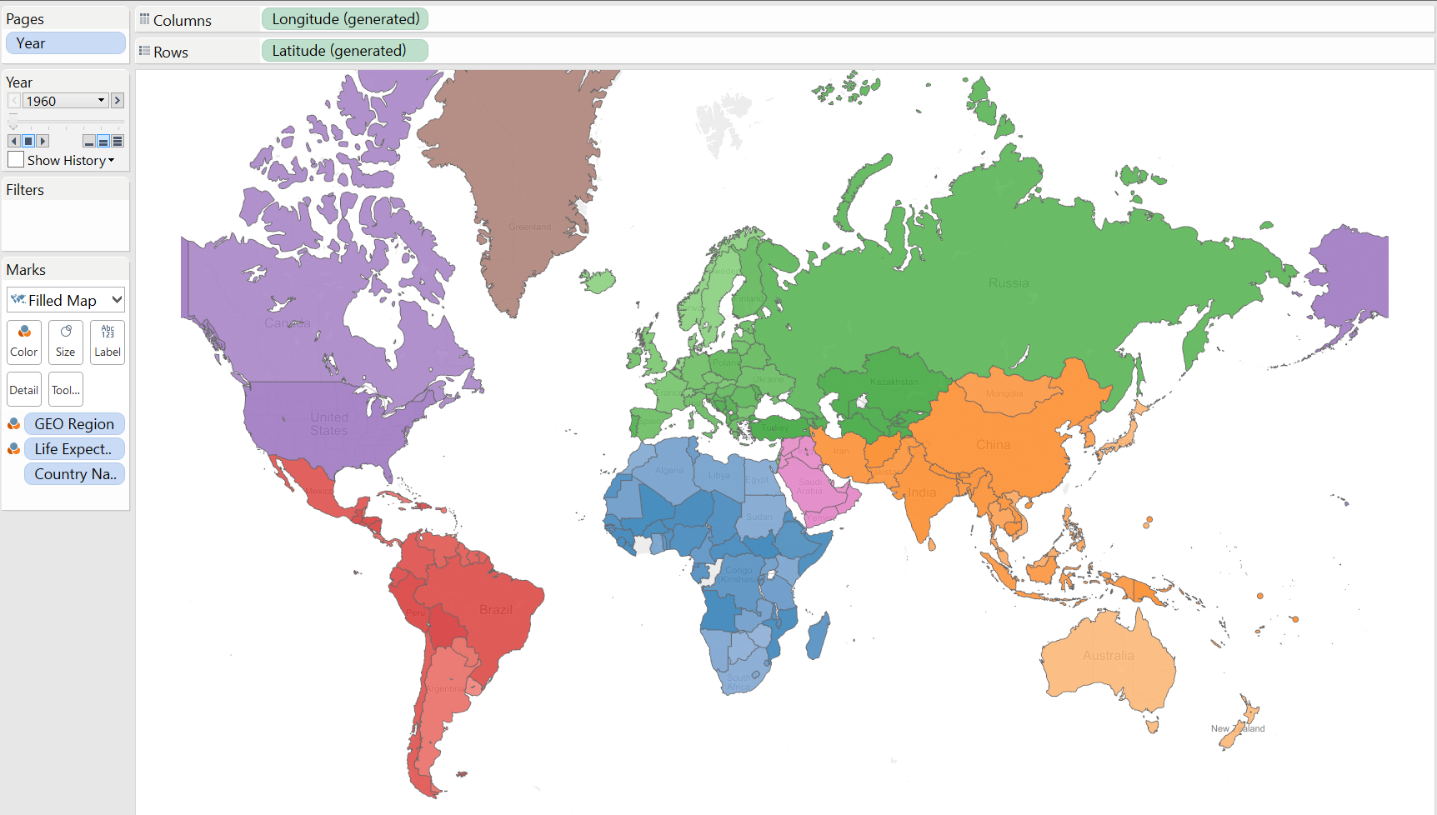
Life Expectancy Map
Notes:
Dual-Level coloring
Pages
Generated Georeferencing

Slide 14
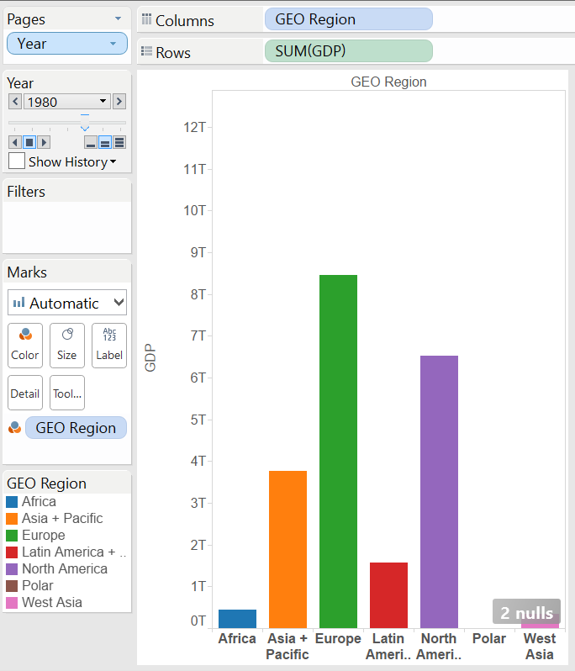
GDP By Region

Slide 15
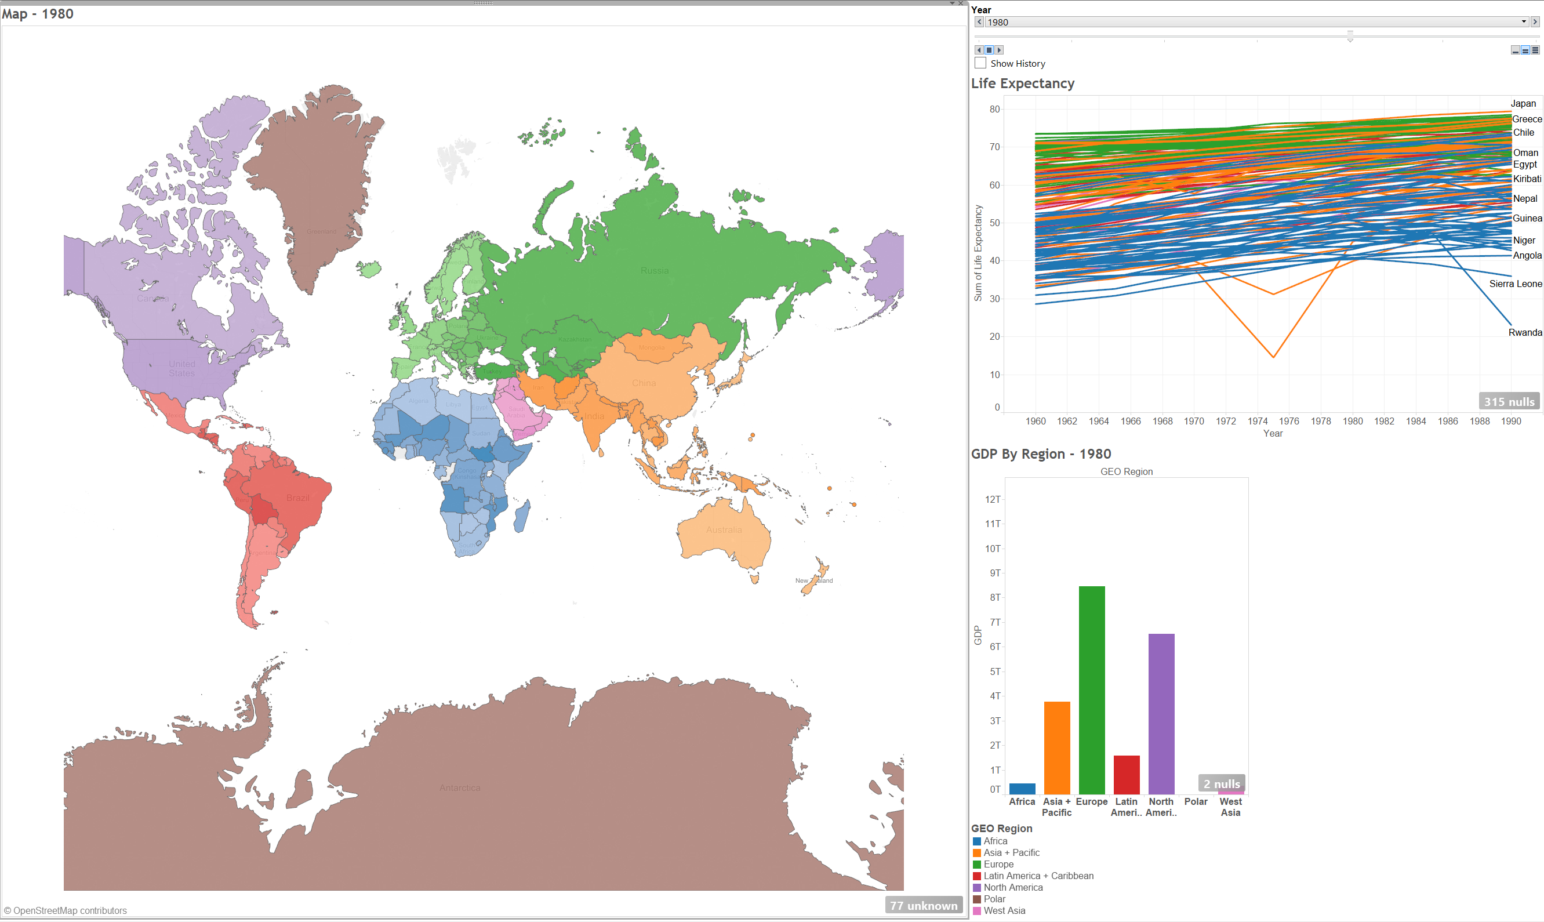
Dashboard
Notes:
Layout

Slide 16
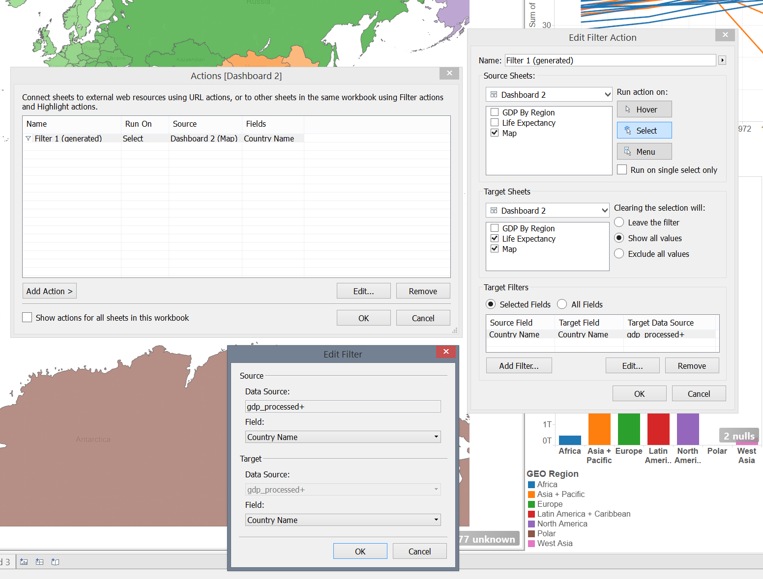
Linking Views
Notes:
Auto Filter and Custom Actions

Slide 17
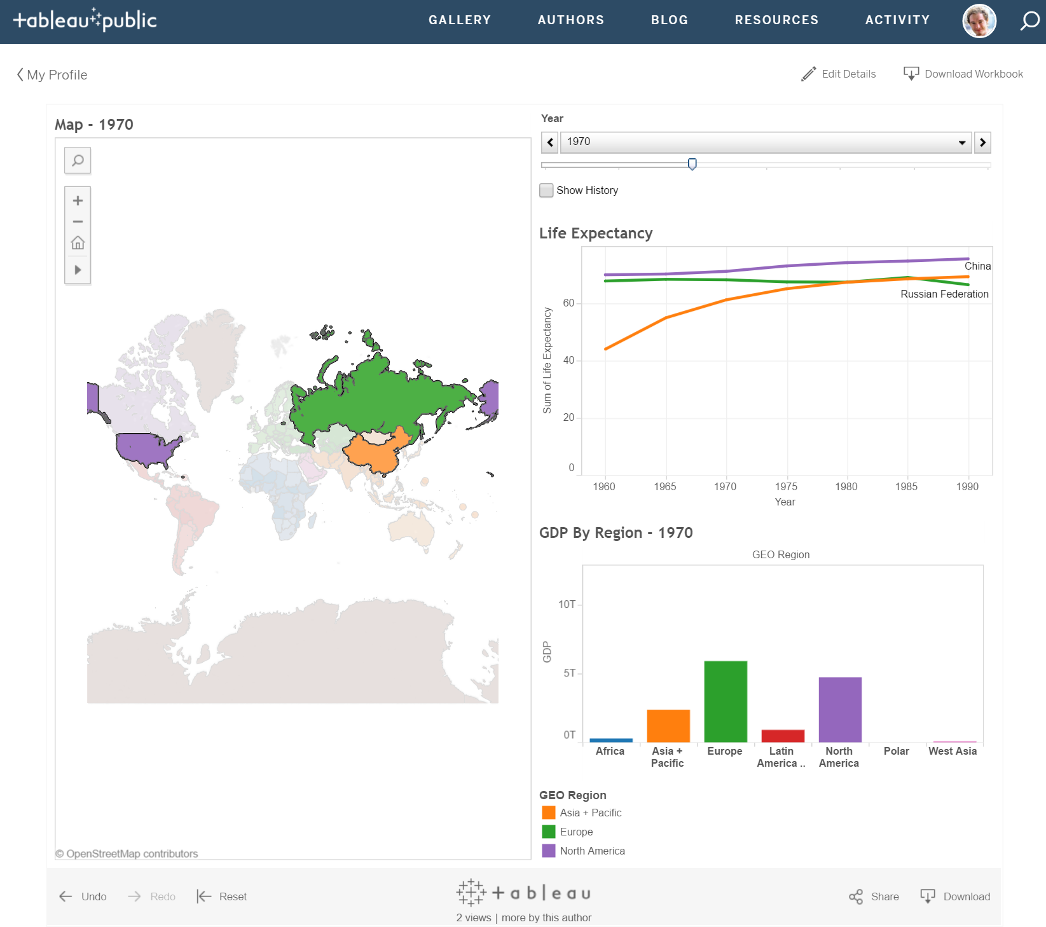
Publishing Views

Slide 18
Visualization Design

Slide 19

Why Visualization
1/3 of our brain is dedicated to visual processing
40% of all nerve fibers connected to the brain come from the retina
Visualization = high speed link to your cognitive system

Slide 20
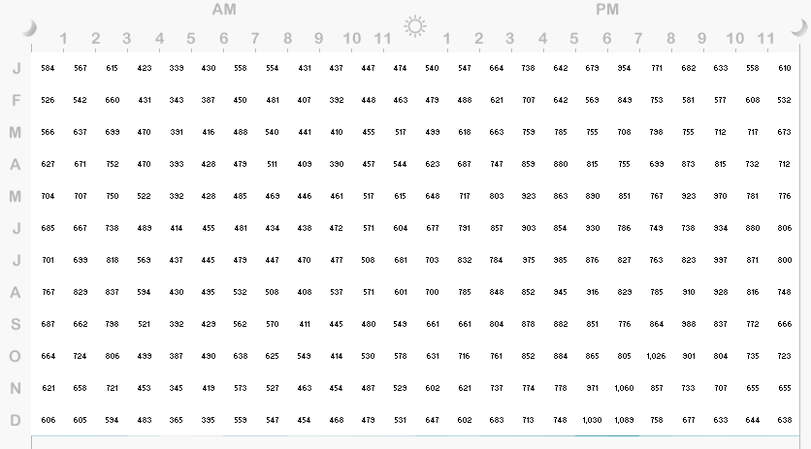
Example
Traffic fatalities by Month/Time of Day. – Do you see any patterns?

Slide 21
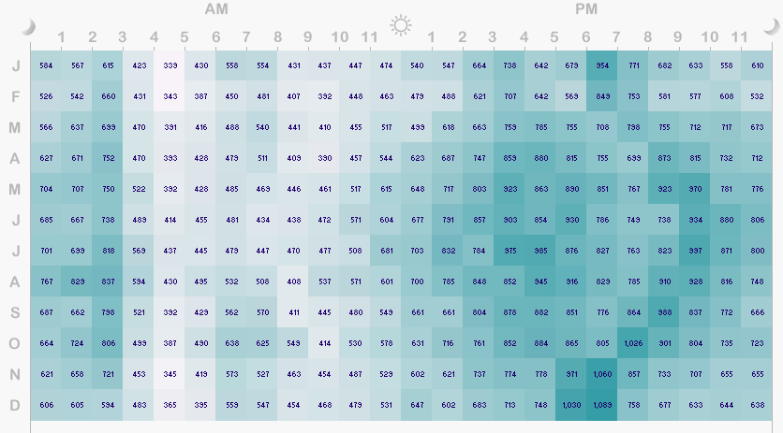
Color-coded values
Comparison & Pattern identification becomes much easier

Slide 22
What is Visualization used for?
Exploratory analysis
You don’t know what is in the data. Visualization helps defining hypotheses
Confirmatory analysis
You know what you are looking for. Visualization helps confirming hypotheses
Storytelling
You use visualization to communicate a specific message
Informative vs Persuasive visualization
Beware of lies and chartjunk!

Slide 23

Why Is Good Visualization Important?
Good visualization conveys correct information concisely and effectively.

Slide 24
Why Is Good Visualization Important?
Bad Visualization can be intentional.

Slide 25
Why Is Good Visualization Important?
Sometimes people’s lives depend on how good a visualization is..

Slide 26
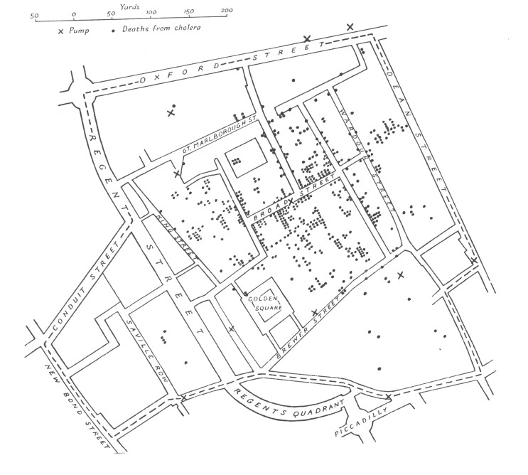
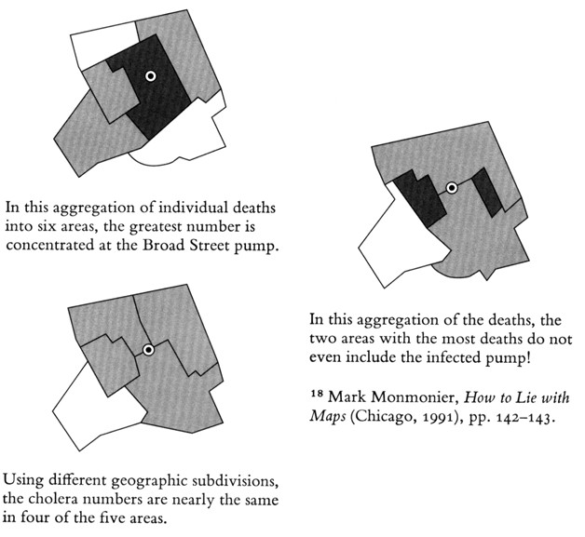
1854 London Cholera outbreak

Slide 27
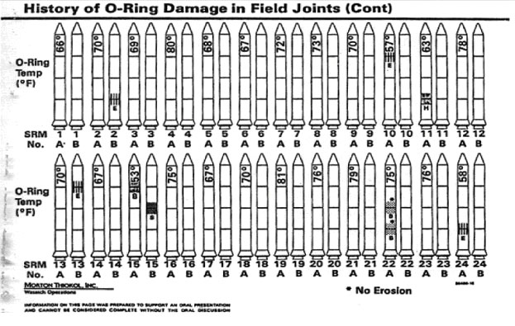
Challenger Disaster
Caused by failing O-rings at low temperature. Engineers tried to warn mission management, using this:

Slide 28
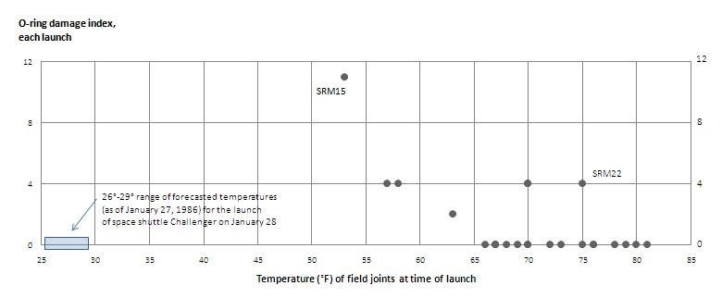
Challenger Disaster
What if this was shown instead?
Original: E. Tufte

Slide 29
Visualization Steps
Filter Data
Choose relevant dimensions
Map to Visual Representation
Position
Frame The Visualization
Axes
Size
Color
Texture
...
Maps
Legend
Annotate
Guidelines
Visual Affordances
Text

Slide 30
Filter Data
Appropriateness Principle – The visual representation should provide neither more nor less information than that needed for the task at hand. Additional information may be distracting and makes the task more difficult. (Norman)
Show only what is needed. If you put two dimensions in same plot, make sure there is something interesting about their relation.
Decide what’s an appropriate interval.
Choose what to do with outliers.

Slide 31
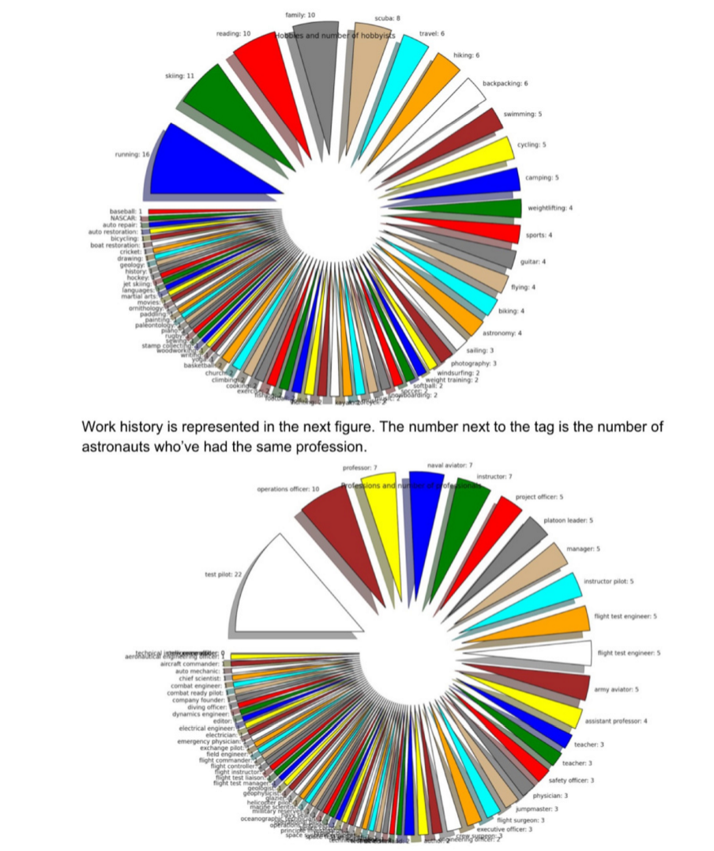
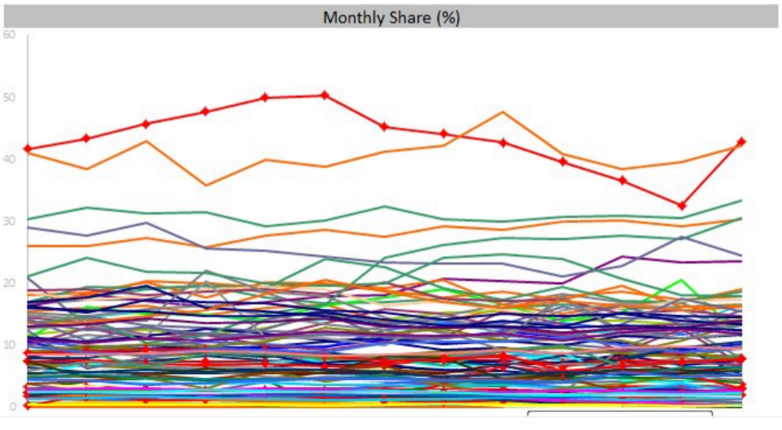
Filter Data
Don’t try to display everything… (interactive vis helps)

Slide 32
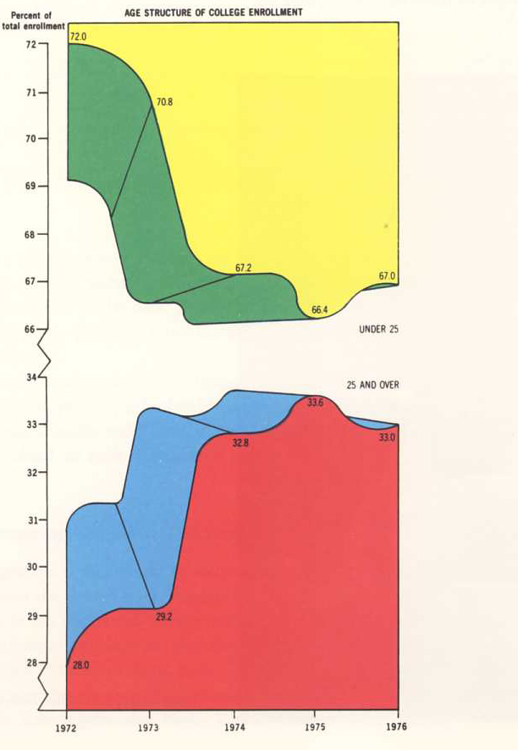
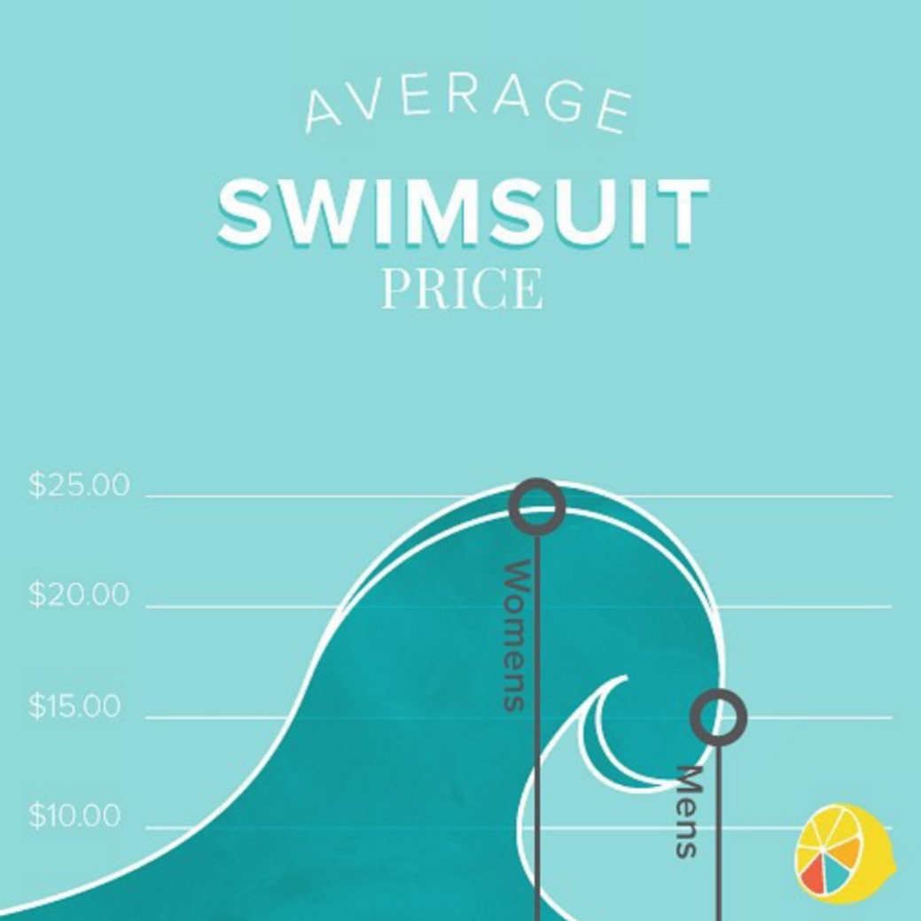
Filter Data
Keep Ink-to-Data ration high

Slide 33
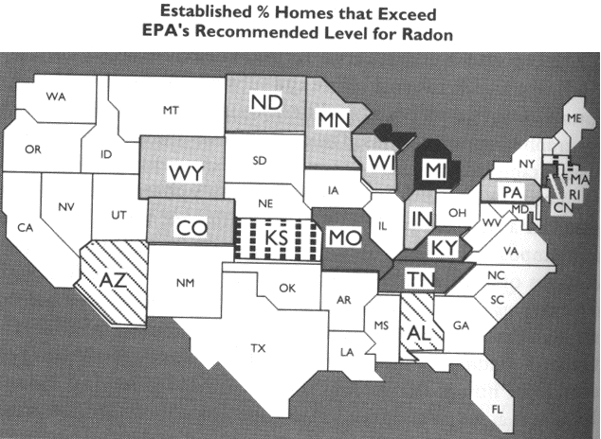
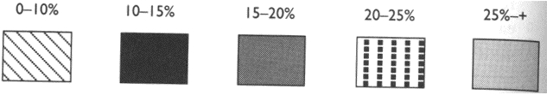
Map to Visual Representation
Categorical vs Continuous data: Texture

Slide 34
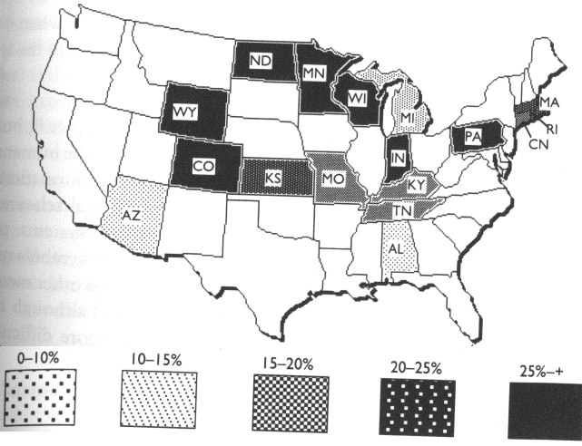
Map to Visual Representation
Categorical vs Continuous data: Texture

Slide 35
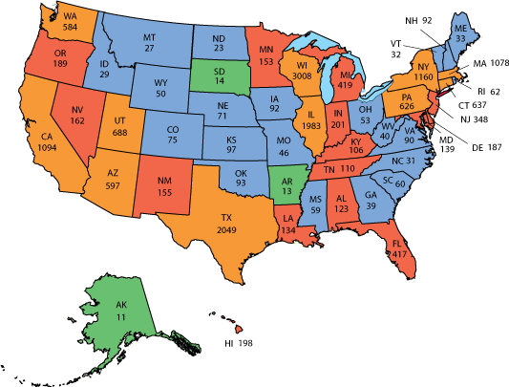
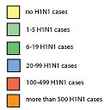
Map to Visual Representation
Categorical vs Continuous data: Color

Slide 36
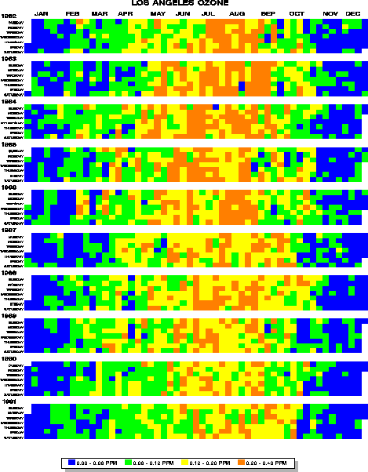
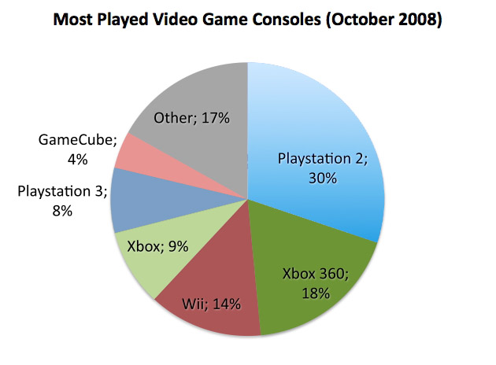
Map to Visual Representation
Categorical vs Continuous data: Color

Slide 37
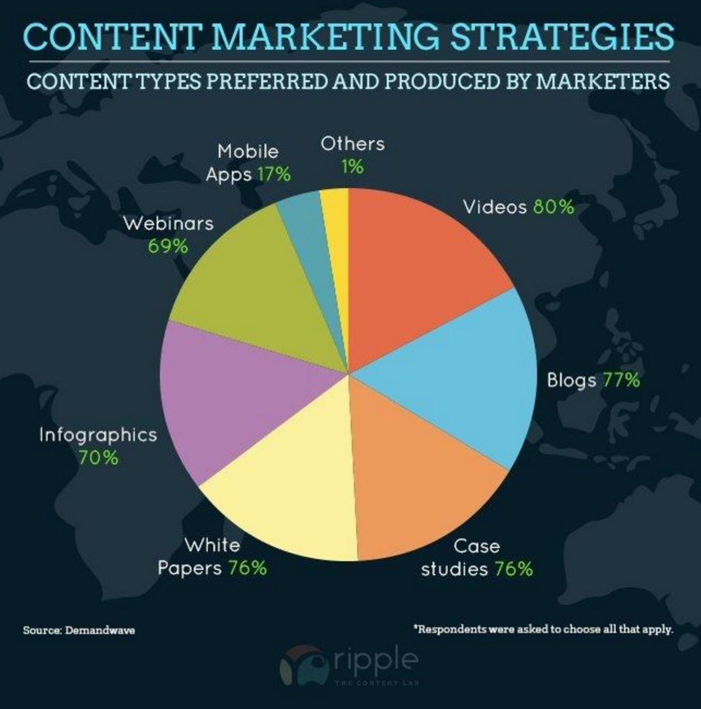
Map To Visual Representation
Make sure you are choosing the correct one…

Slide 38
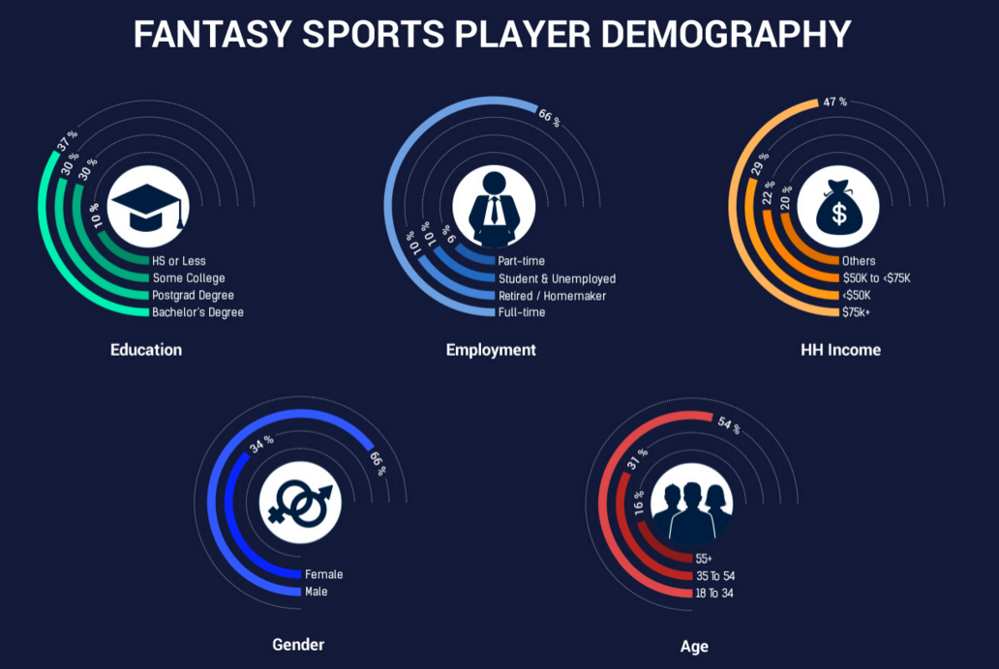
Map To Visual Representation
Make sure you are choosing the correct one…

Slide 39
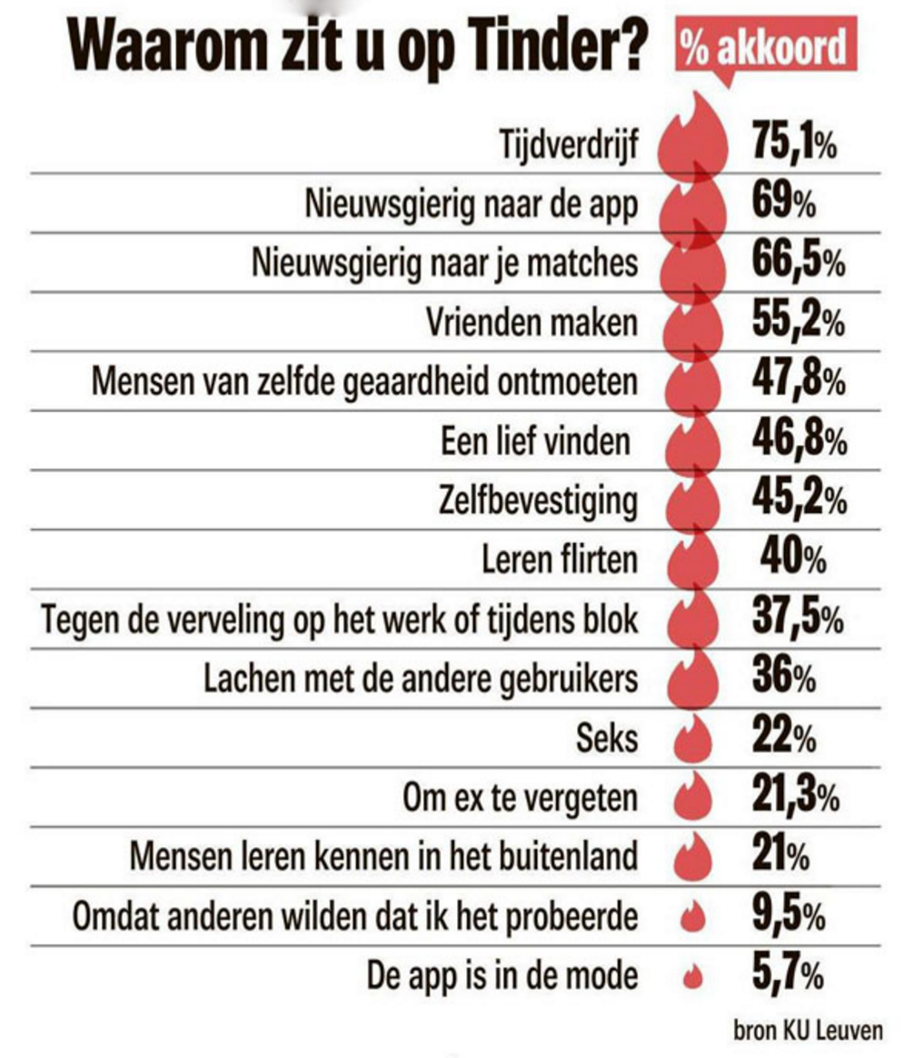
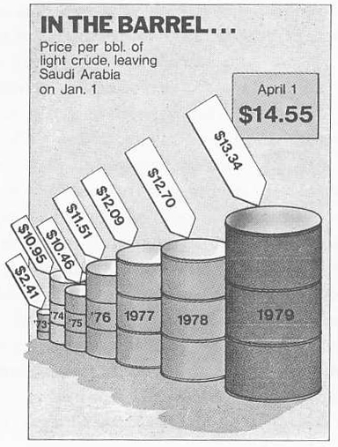
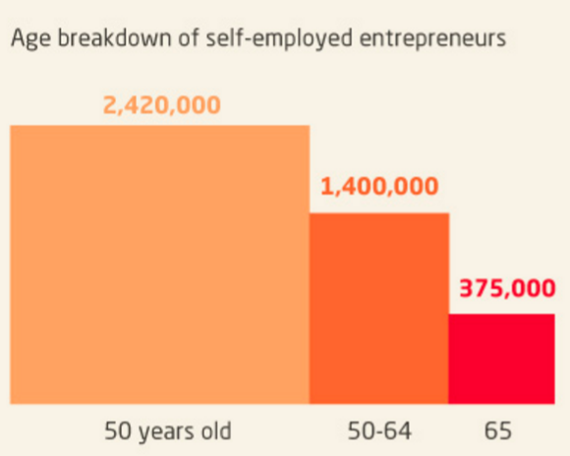
Map To Visual Representation
Do not map single data dimension to multiple visual dimensions
Typical error: object scale -- Keep pixel-to-data ratio high

Slide 40
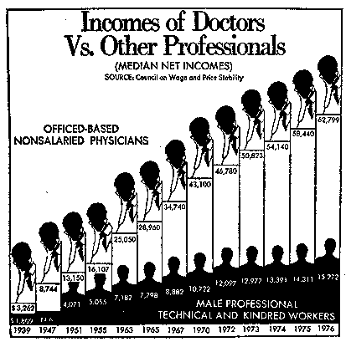
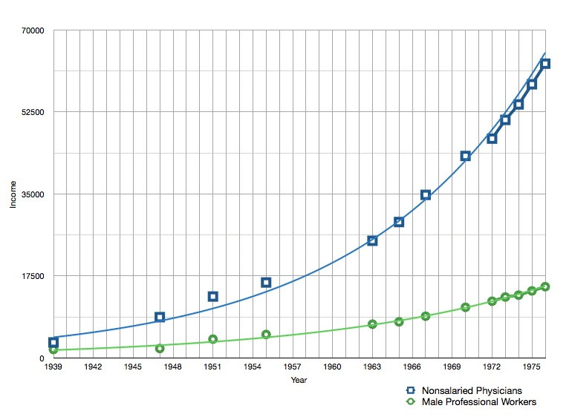
Frame The Visualization
Axes & Scale
Linear is best
Use log scale when needed, but make sure your viewer knows!
Keep scale consistent!

Slide 41
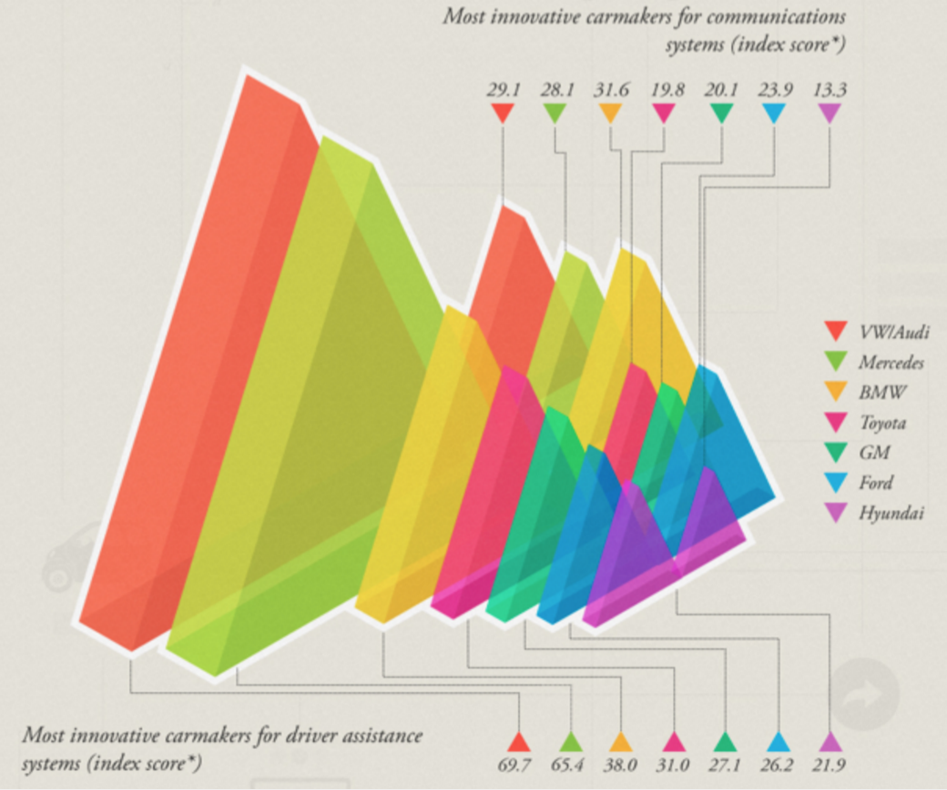
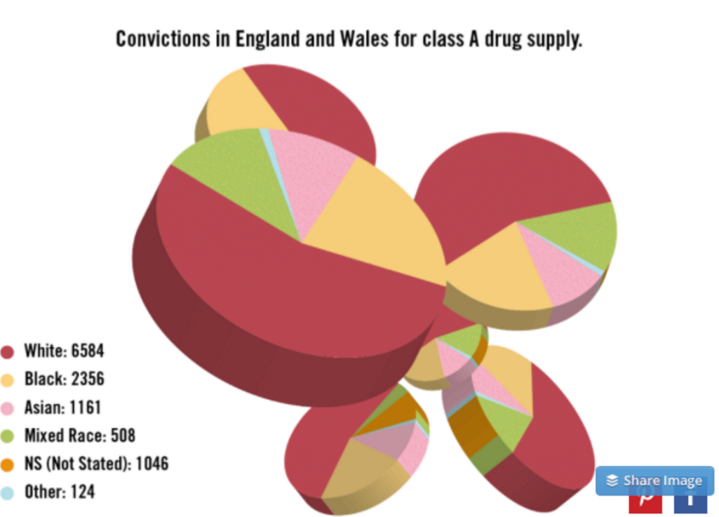
Frame The Visualization
Don’t use 3D to display 1/2D data!
It Can be useless...

Slide 42
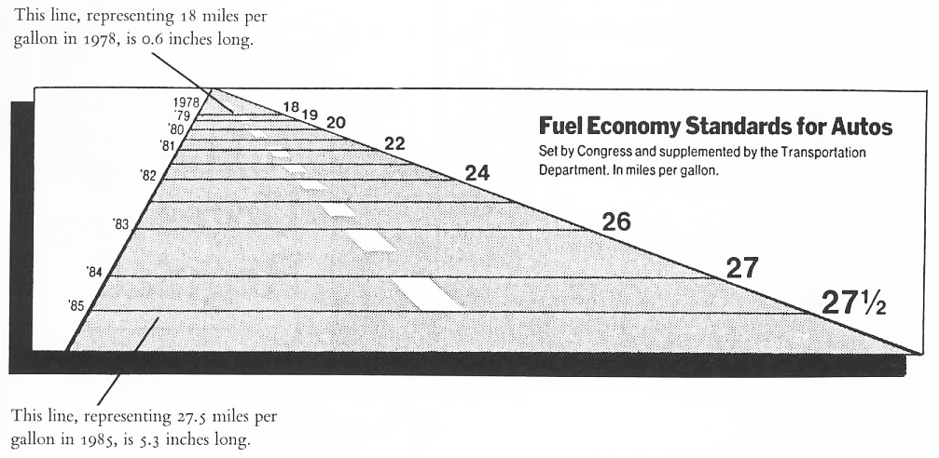
Frame The Visualization
Don’t use 3D to display 1/2D data!
…Or it can turn your visualization into a lie!

Slide 43
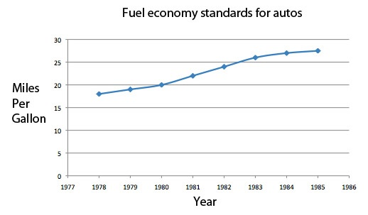
Frame The Visualization
MPG Standards with lie factor removed

Slide 44
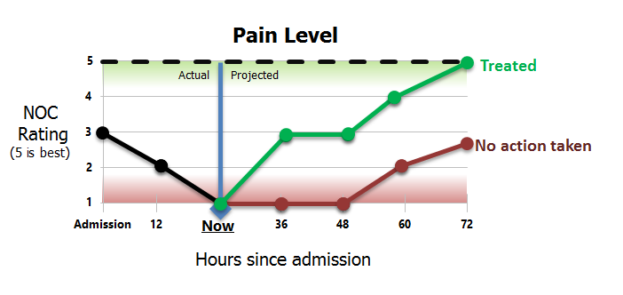
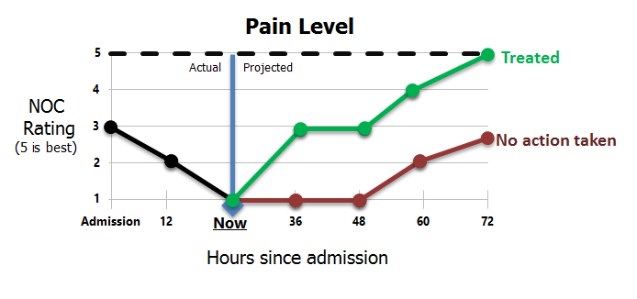
Annotate
Visual Affordances help interpret information, avoid mistakes in time-constrained decision making
Is Pain level 5 good or bad?
Color bars help disambiguate pain level meaning

Slide 45
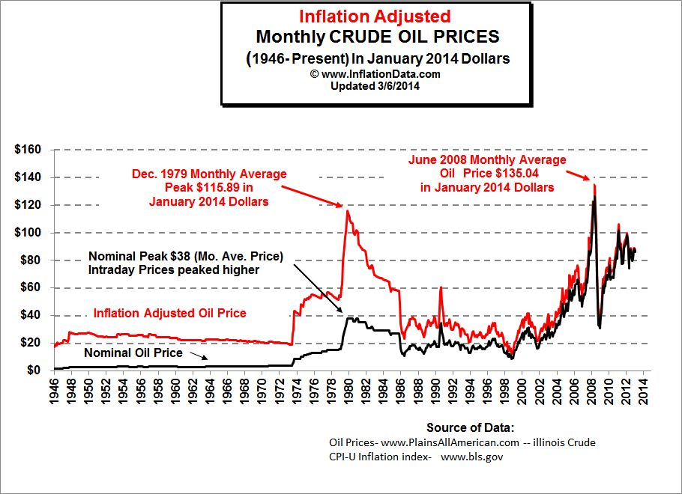
Annotate
Mark meaningful events on a plot
Report sources

Slide 46
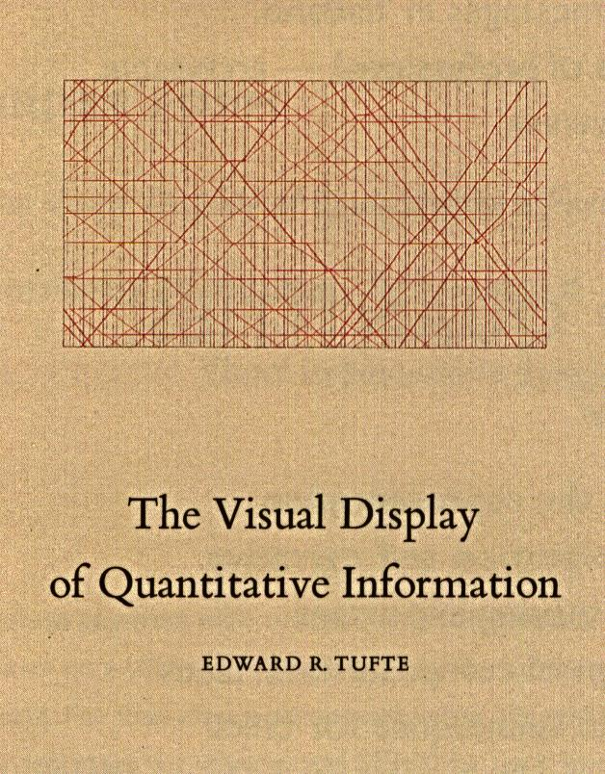
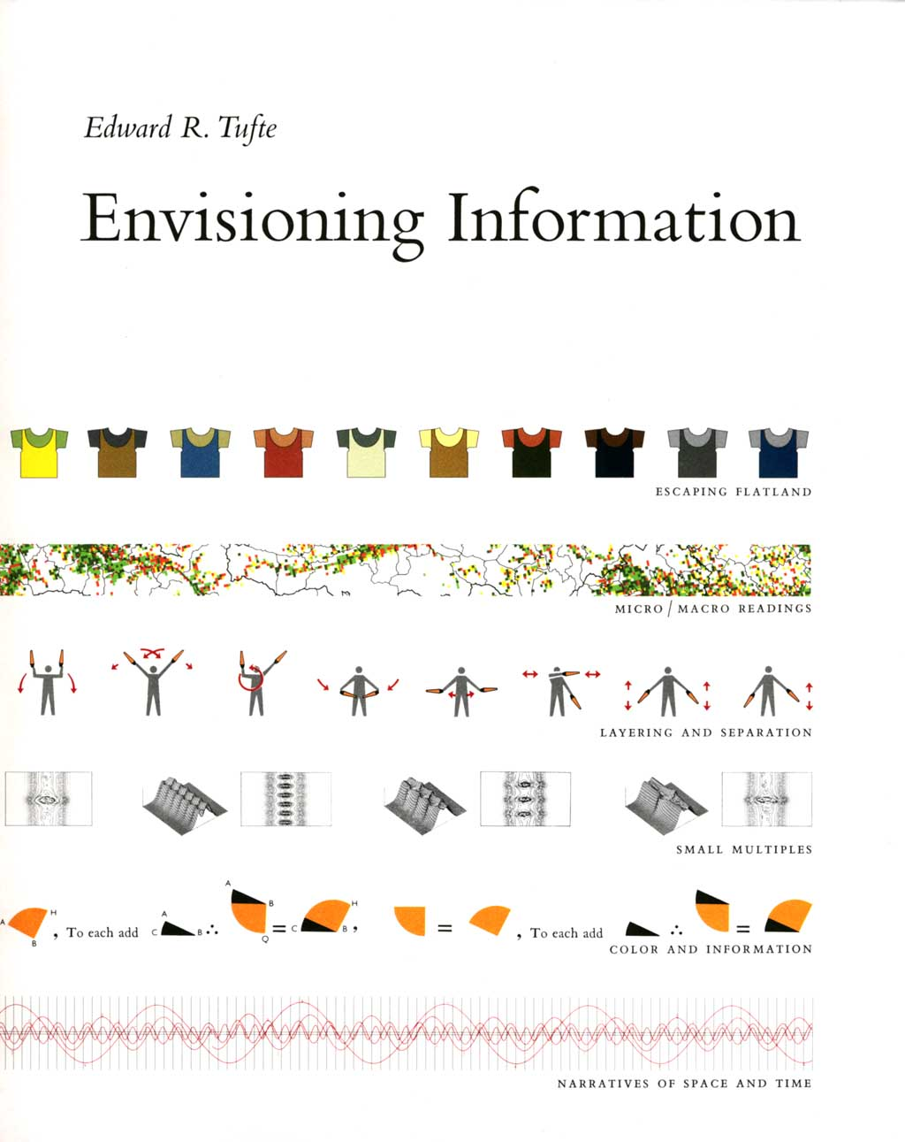
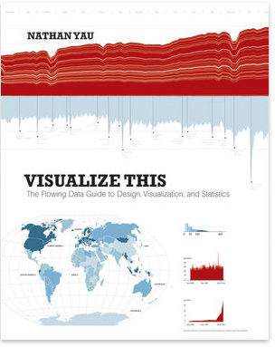
Resources
http://flowingdata.com/
http://www.datavis.ca/gallery/

Slide 47

Thanks!
alessandro.febretti@northwestern.edu
visualization.northwestern.edu
Notes:
38

